Slide 1
UML Diagrams
Shadheen - Online Employment Exchangement Portal

Slide 2
Group Members
Asifujjaman Opi - 011181295
Md. Shahriar Asif Rezan -011181040
Khorshed Alam - 011181173
Alok Das - 011181236
Apu Chandra Bhowmick - 011181291
Md. Sabbir Sarkar - 011181197

Slide 3
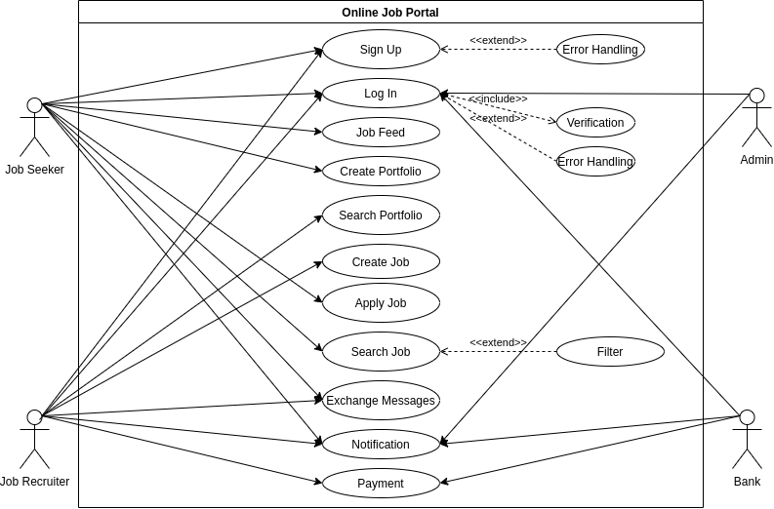

Slide 4
UC 03: Job Feed
Primary Actor: Job Seeker
Stakeholders and Interests:
Job Seeker:
As Job Feed will update for a job seeker with popular jobs, skill, location, salary range, favorite keyword and company they follow.
Job Recruiter:
New jobs posted by Job Recruiter will be shown to Job Feed.
Admin Panel:
Admins can remove spam job post to keep job feed clean.

Slide 5
Pre Condition:
User must have prior an account to see their job feed.
There must have at least some jobs to show on job feed.
Job post must have details about the job.
As well as, job seeker have to give their details.
Post Condition:
Everything will remain same unless other feature overwrites database.

Slide 6
Main Success Scenario
Job seeker will get notified if there is new messages or notification
Job seeker can see their job feed
Job seeker can navigate through available jobs
Job seeker can view any job by clicking the job title
Job seeker can apply the job

Slide 7
Alternative Scenario
*a. The system may not respond
Solution: Wait for the system to respond
1a. Job seeker may not get notified
Solution: Contact with system admin
2a. Job seeker my not see posts in job feed
Solution: Update your profile information
3a. Job seeker can’t view by clicking job title
Solution: Refresh the browser
Issues
Job seeker preferences are not common in our database, Then error will be shown.

Slide 8
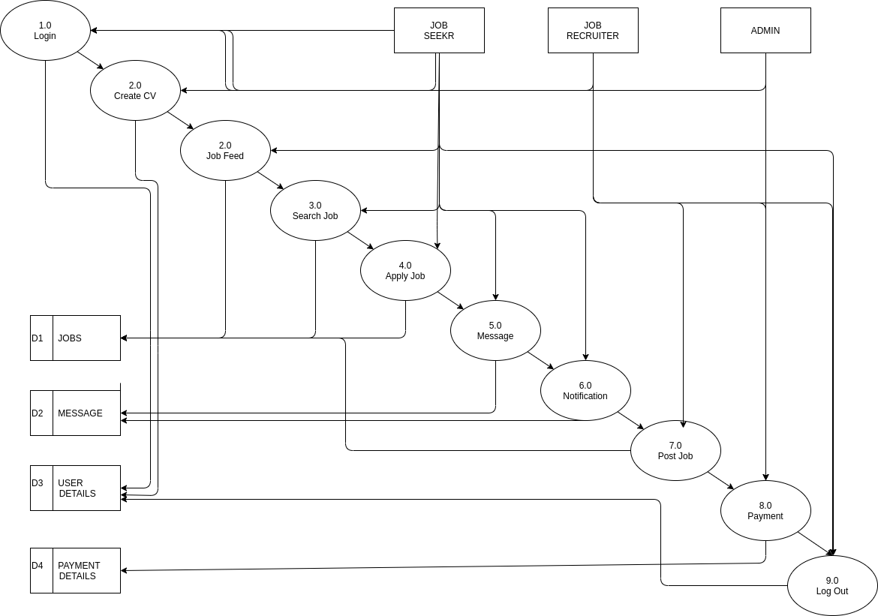

Slide 9
